Slide 1

PSET 4: Nomor 1 Praktik
Hocky Yudhiono
Art By: https://www.deviantart.com/merueki

Slide 2

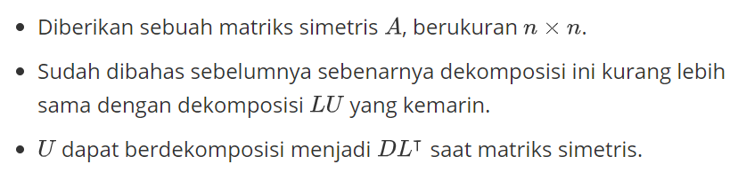
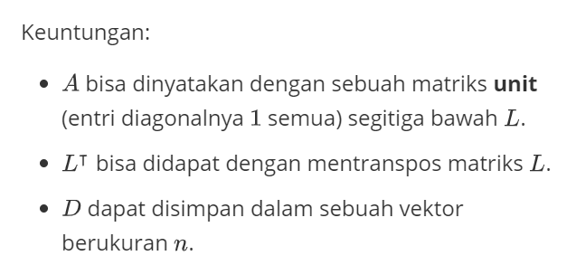
LDL’ Factorization

Slide 3

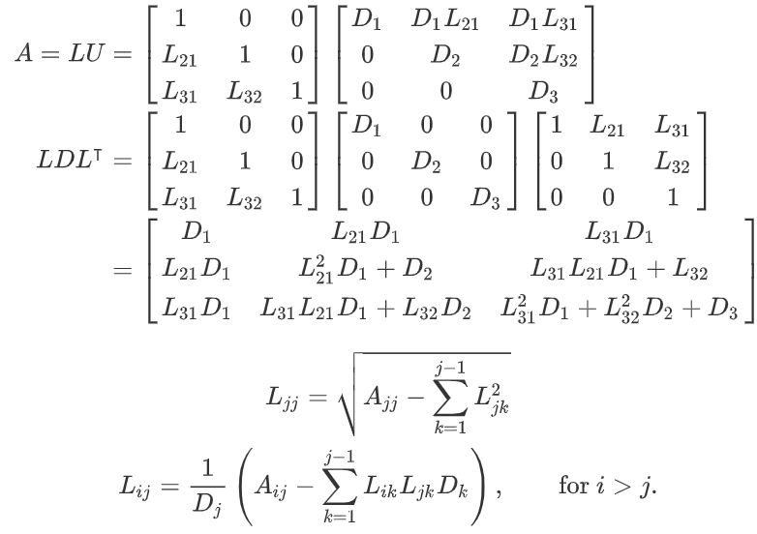
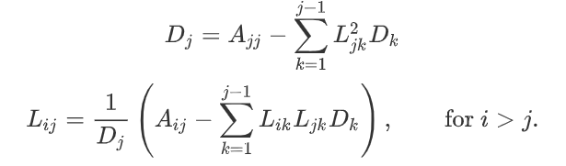







LDL’ Factorization

Slide 4

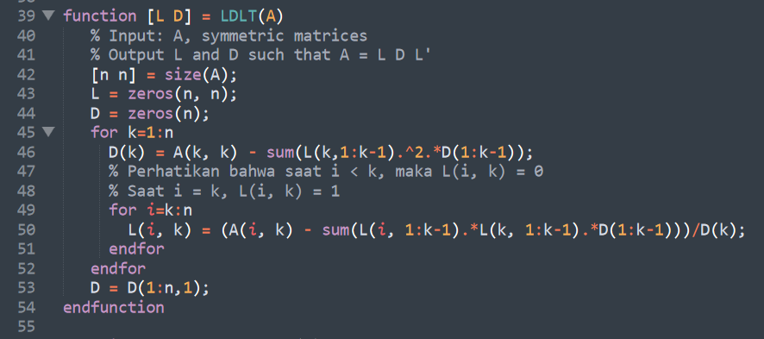
LDL’ Factorization

Slide 5
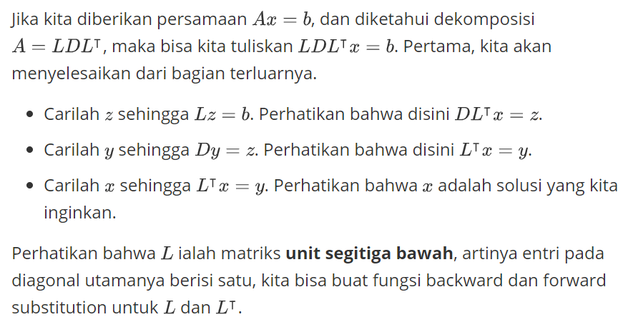



Slide 6


LDL’ Factorization w/ Diagonal Pivoting

Slide 7
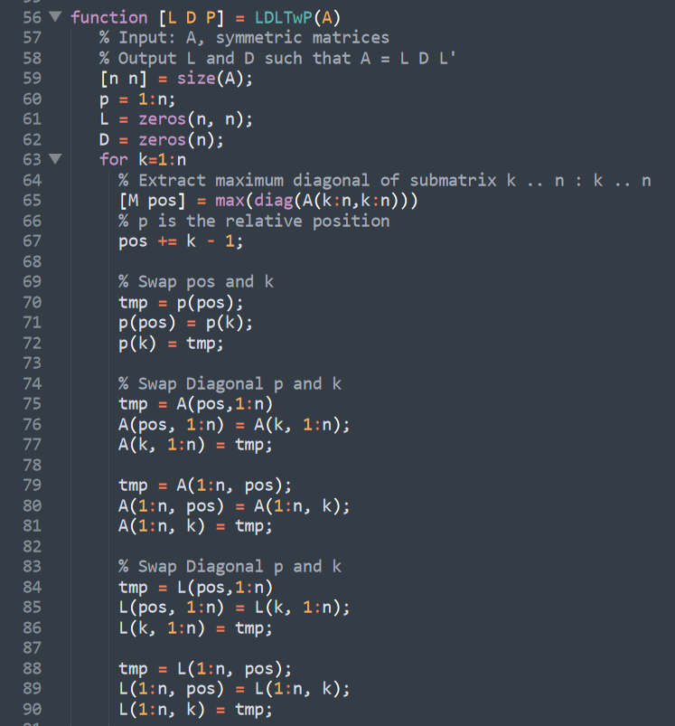
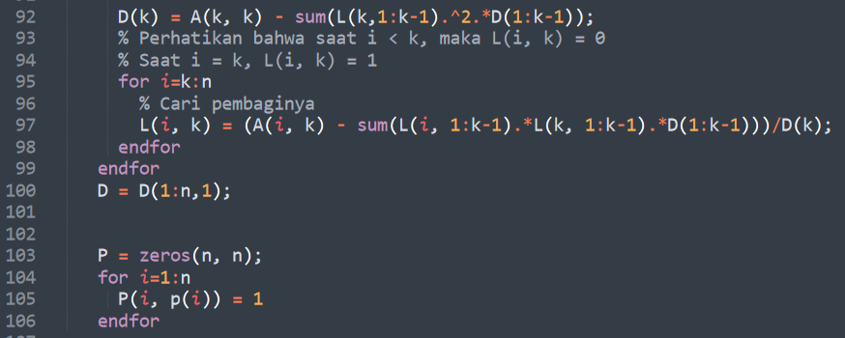


LDL’ Factorization w/ Pivoting

Slide 8
Octave

Slide 9
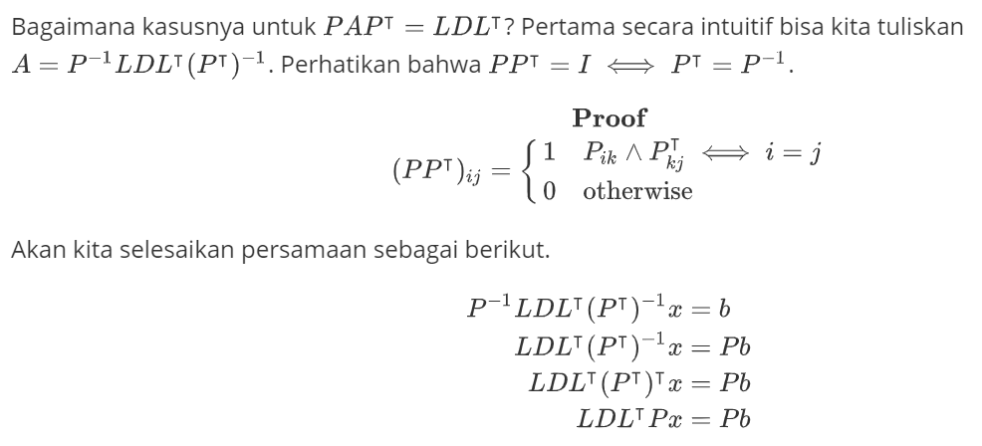

Slide 10
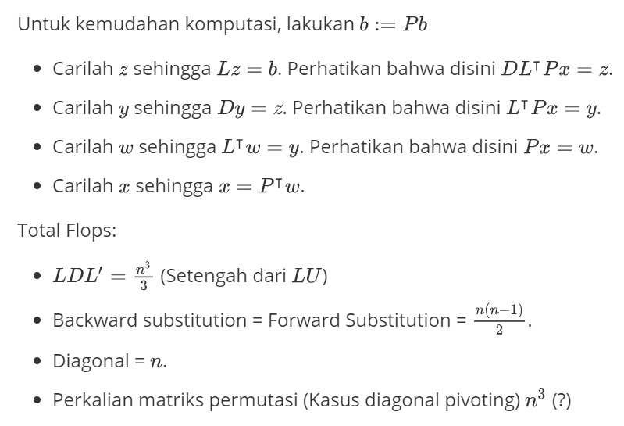

Slide 11
Octave

Slide 12

Thank You

